Slide 1
Travel budget estimator
Vishwas SR

Slide 2
Why tourism?

Slide 3
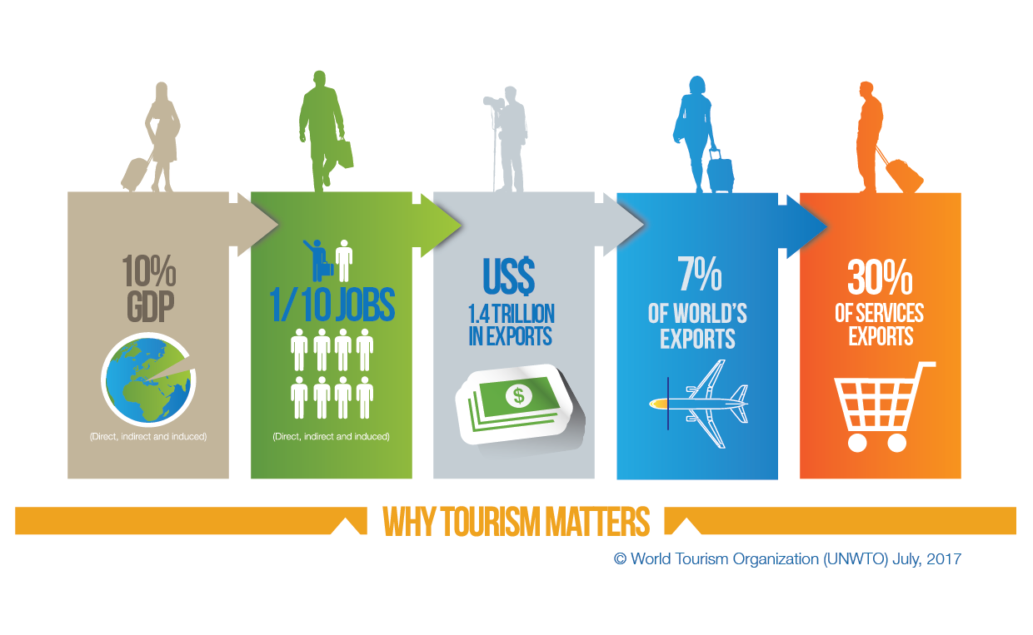
Notes:
Tourism has become an important sector that has an impact on development of country economy.
For many regions and countries it is the most important source of welfare

Slide 4
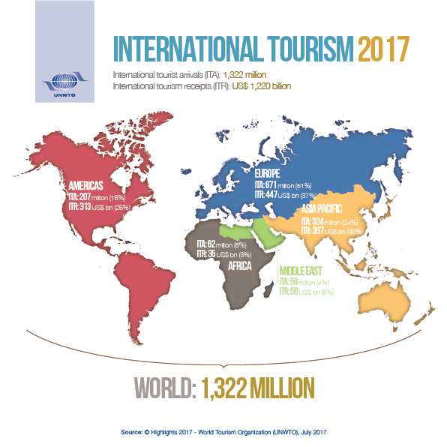
Notes:
1.3 billion international tourists.
The WTO predicts that it will reach 2B by 2030, so it is an important sector for business.

Slide 5
Challenges of planning?
Notes:
Budget is a major challenge in planning

Slide 6
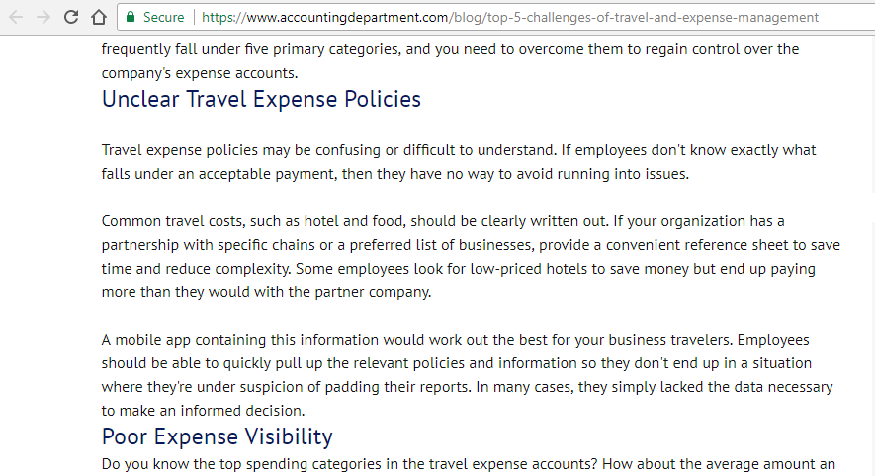
Notes:
Confusing transport expenses
Omitting common costs such as the hotel or food

Slide 7
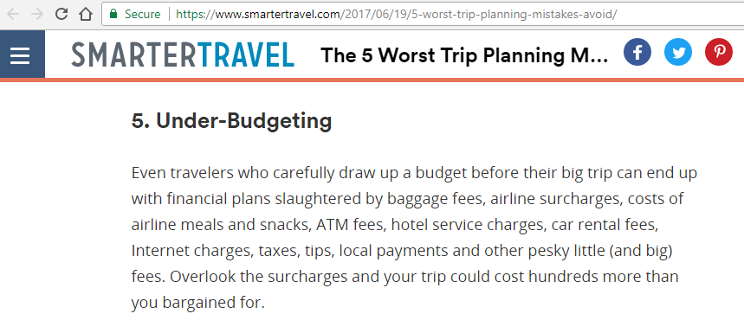
Notes:
Mainly faced problem by many users is under budgeting which may lead to a disappointing experience.
Getting the budget right is an important factor in planning

Slide 8
Existing systems (Majority)
Inputs
Ouput
BUDGET
Number of days
Type of destinations
Number of people
And
A
Few
More
DESTINATIONS & ATTRACTIONS
Notes:
Existing systems takes these parameters as inputs and they give out recommendation for destinations and attractions.
Budget is one of the major inputs that these systems take.

Slide 9
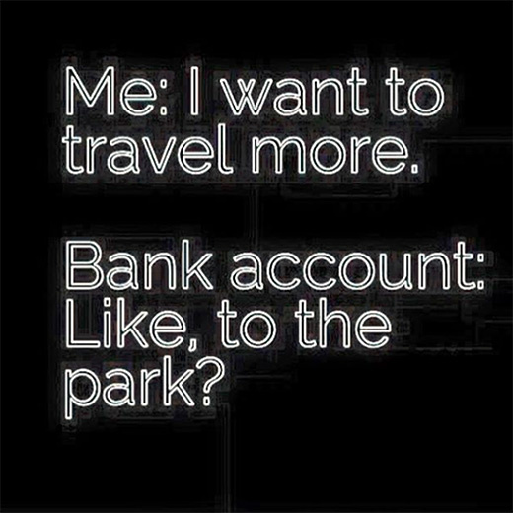
WANDERLUST
https://wanderlustcalls.com/2017/02/13/ten-funny-but-relatable-travel-memes/
Notes:
What if we’re unable to estimate the budget properly?
Missing out on things – attractions, local food, comfy stay etc

Slide 10
How to make a travel budget?
Make a budget for major transportation
Make a budget for other transportation
Make a budget for your accommodation
Make a budget for food
Make a budget for activities
Notes:
Simple, right?
Doing it manually would take a lot of time and effort.

Slide 11
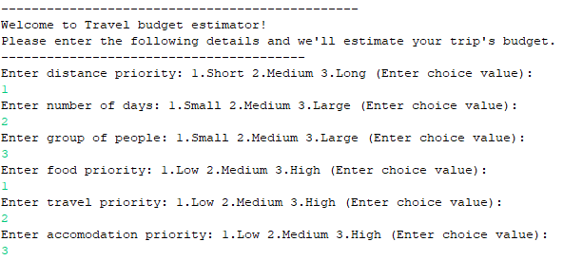
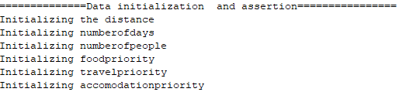
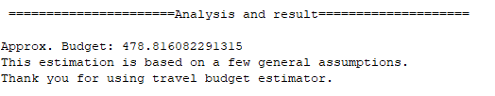
Notes:
Just a prototype for how budget estimating could be handled – implemented using the fuzzy jess
System takes in user priorties and inputs for different categories such as -

Slide 12
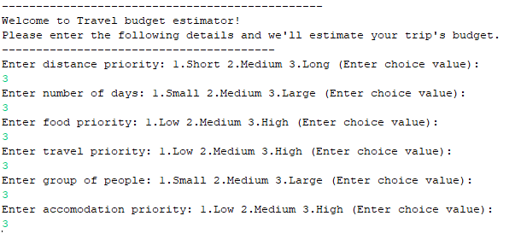
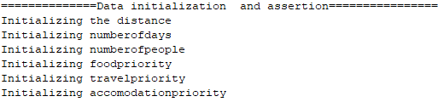
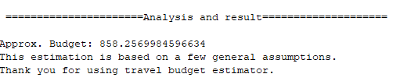

Slide 13
Limitations
Needs fine tuning
Making the system more reliable and available
Enhanced user experience
Notes:
Current system needs fine tuning
Exisitng systems need to be more available and reliable
User ex matters to attract all kinds of users

Slide 14
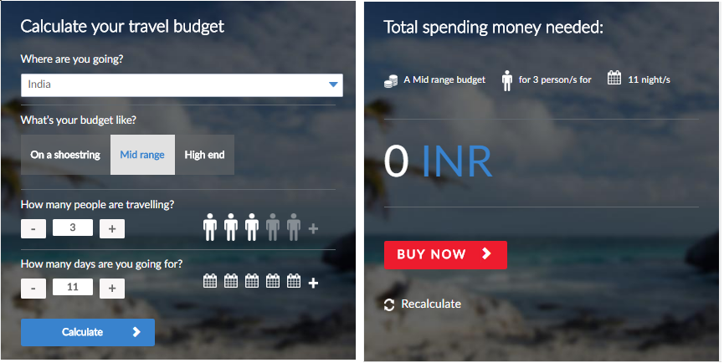

Slide 15
Future improvements
Including more categories of
user inputs
Recommendation at different
categories
Notes:
More categories of user inputs and different ways of collecting inputs (range, etc)

Slide 16
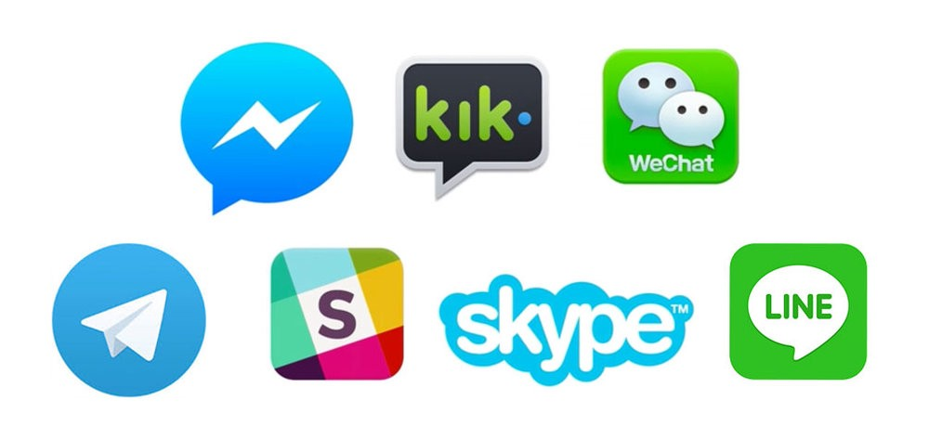
System availability - chatbots
https://chatbotslife.com/popular-list-of-chatbot-supported-social-media-and-messaging-platforms-4d43434e4ee1

Slide 17
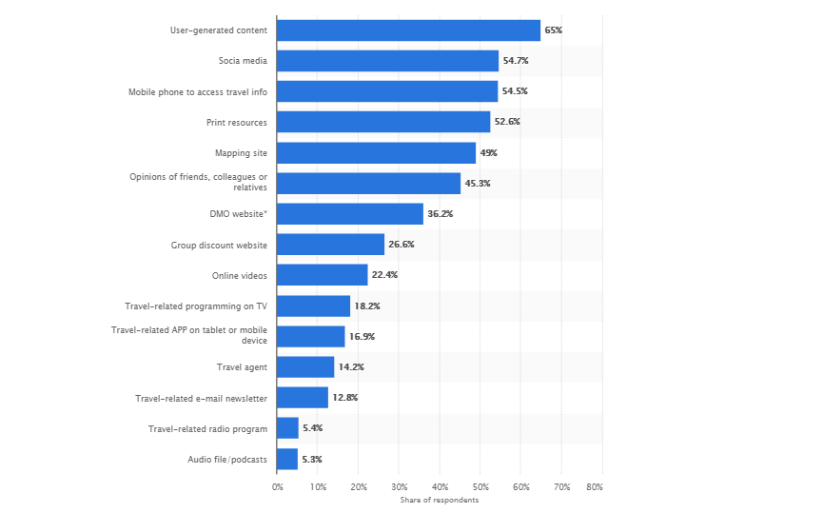
Data utilization

Slide 18
Thank you!
https://www.travelex.com.au/rates/travel-budget-calculator
http://media.unwto.org/content/infographics
https://chatbotslife.com/popular-list-of-chatbot-supported-social-media-and-messaging-platforms-4d43434e4ee1
http://rorchard.github.io/FuzzyJ/

